Slide 1
Fortran プリプロセッサの開発と 球MHDシミュレーション
CS52 シミュレーション技法研究室
188x218x 細山田真也
指導教員 陰山 聡教授
修論公聴会 2020年2月１３日

Slide 2
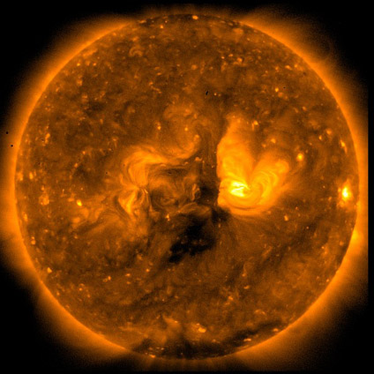
研究背景と目的
緩和現象
研究背景
MHD流体の性質とは何か？
→ 緩和現象
高エネルギー
エネルギー
低エネルギー
時間
MHD（MagnetoHydro Dynamics：磁気流体力学）
に則る流体のこと
例：太陽プラズマ、液体鉄など
http://spaceinfo.jaxa.jp/ja/sun.html
Notes:
This is the outline my talk today.
First, I will present background of my purpose today.
Then, I will introduce some features of our direct named efortan.
And , I will explane those features with sample source codes.

Slide 3
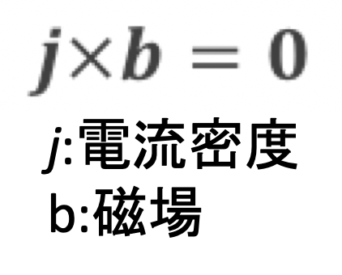
研究背景と目的
先行研究
J.B.Taylor：Taylor理論を提唱。緩和後は力がどこにもかからない状態（force-free状態）になる。
→ 緩和状態で流れがないものと仮定
→ 一般的に緩和状態で流れはある
→ 未完成なMHD緩和理論
Notes:
This is the outline my talk today.
First, I will present background of my purpose today.
Then, I will introduce some features of our direct named efortan.
And , I will explane those features with sample source codes.

Slide 4
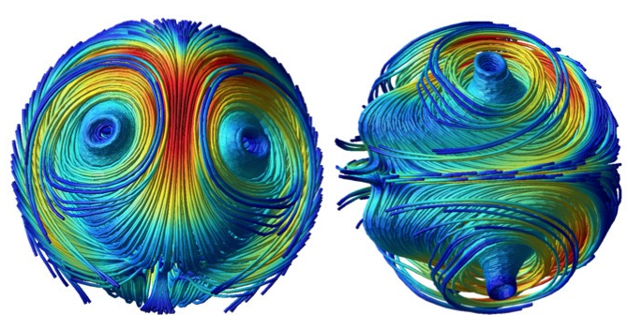
研究背景と目的
研究目的
流れがある緩和状態とは何か？
流れなし
→ Taylor理論
流れあり、初期磁場の形状：リング状
→ 先行研究（Yamamotoら）
流れあり、初期磁場の形状：その他
→ 本研究
Notes:
This is the outline my talk today.
First, I will present background of my purpose today.
Then, I will introduce some features of our direct named efortan.
And , I will explane those features with sample source codes.

Slide 5
研究手法とモデル
研究手法
球状容器内部にMHD流体を満たし、初期状態を決める。
→ 時間を進めるとどうなる？
→ 最終的な状態（緩和状態）は？
Yin-Yang-Zhong格子を用いた球MHDシミュレーション
Notes:
This is the outline my talk today.
First, I will present background of my purpose today.
Then, I will introduce some features of our direct named efortan.
And , I will explane those features with sample source codes.

Slide 6
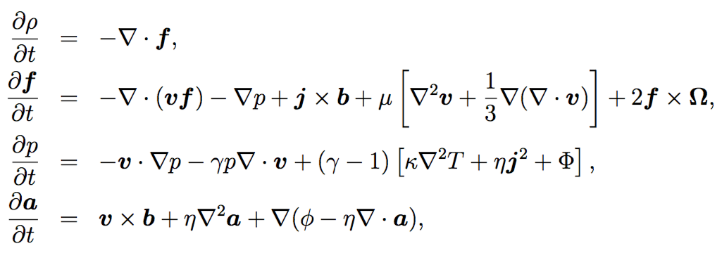
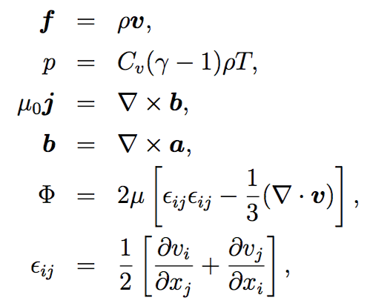
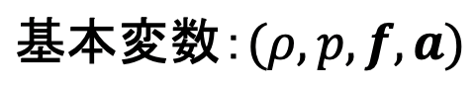
研究手法とモデル
シミュレーションモデル
MHD方程式
質量密度
速度場
比熱比
温度
定積比熱
磁場
磁場のベクトルポテンシャル
粘性係数
Notes:
This is the outline my talk today.
First, I will present background of my purpose today.
Then, I will introduce some features of our direct named efortan.
And , I will explane those features with sample source codes.

Slide 7
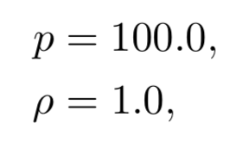
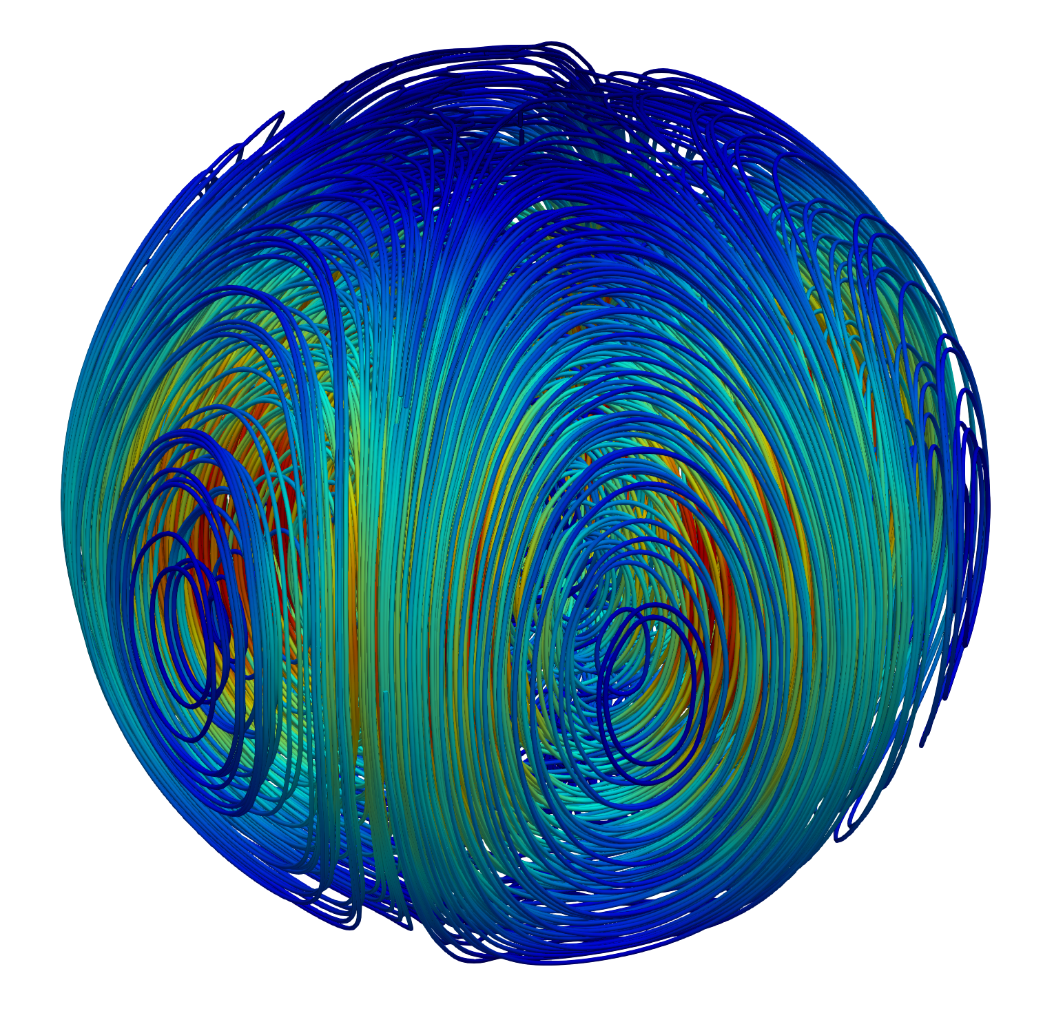
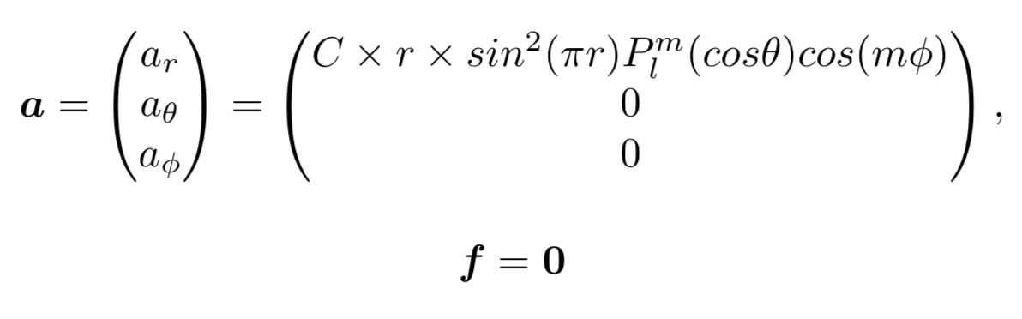
研究手法とモデル
初期状態（t=0のとき）
球内部一様
球面調和関数
Notes:
This is the outline my talk today.
First, I will present background of my purpose today.
Then, I will introduce some features of our direct named efortan.
And , I will explane those features with sample source codes.

Slide 8
シミュレーション結果
シミュレーション結果
Notes:
This is the outline my talk today.
First, I will present background of my purpose today.
Then, I will introduce some features of our direct named efortan.
And , I will explane those features with sample source codes.

Slide 9
境界条件の変更
Stress-free 境界
rigid 境界
0
v
0
v
0
Notes:
Rigid境界の方が自然界で一般的
問題になるのは流れのエネルギーが消えてしまうこと

Slide 10
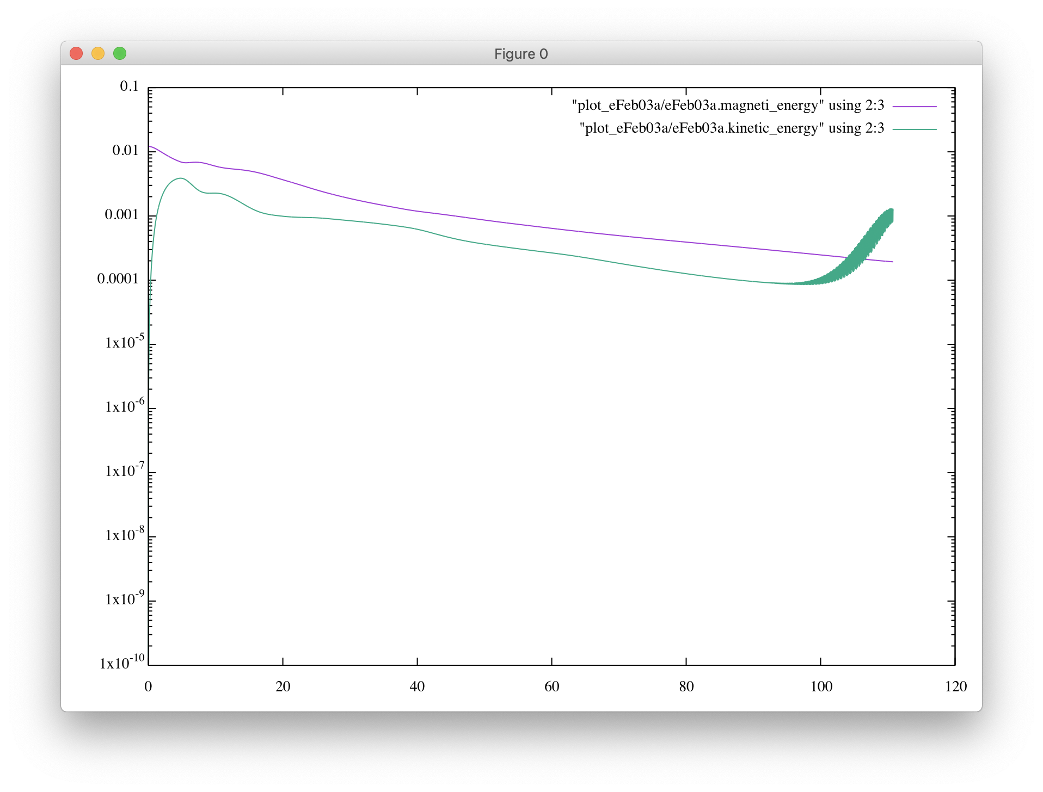
境界条件の変更
Notes:
Rigid境界の方が自然界で一般的
問題になるのは流れのエネルギーが消えてしまうこと

Slide 11
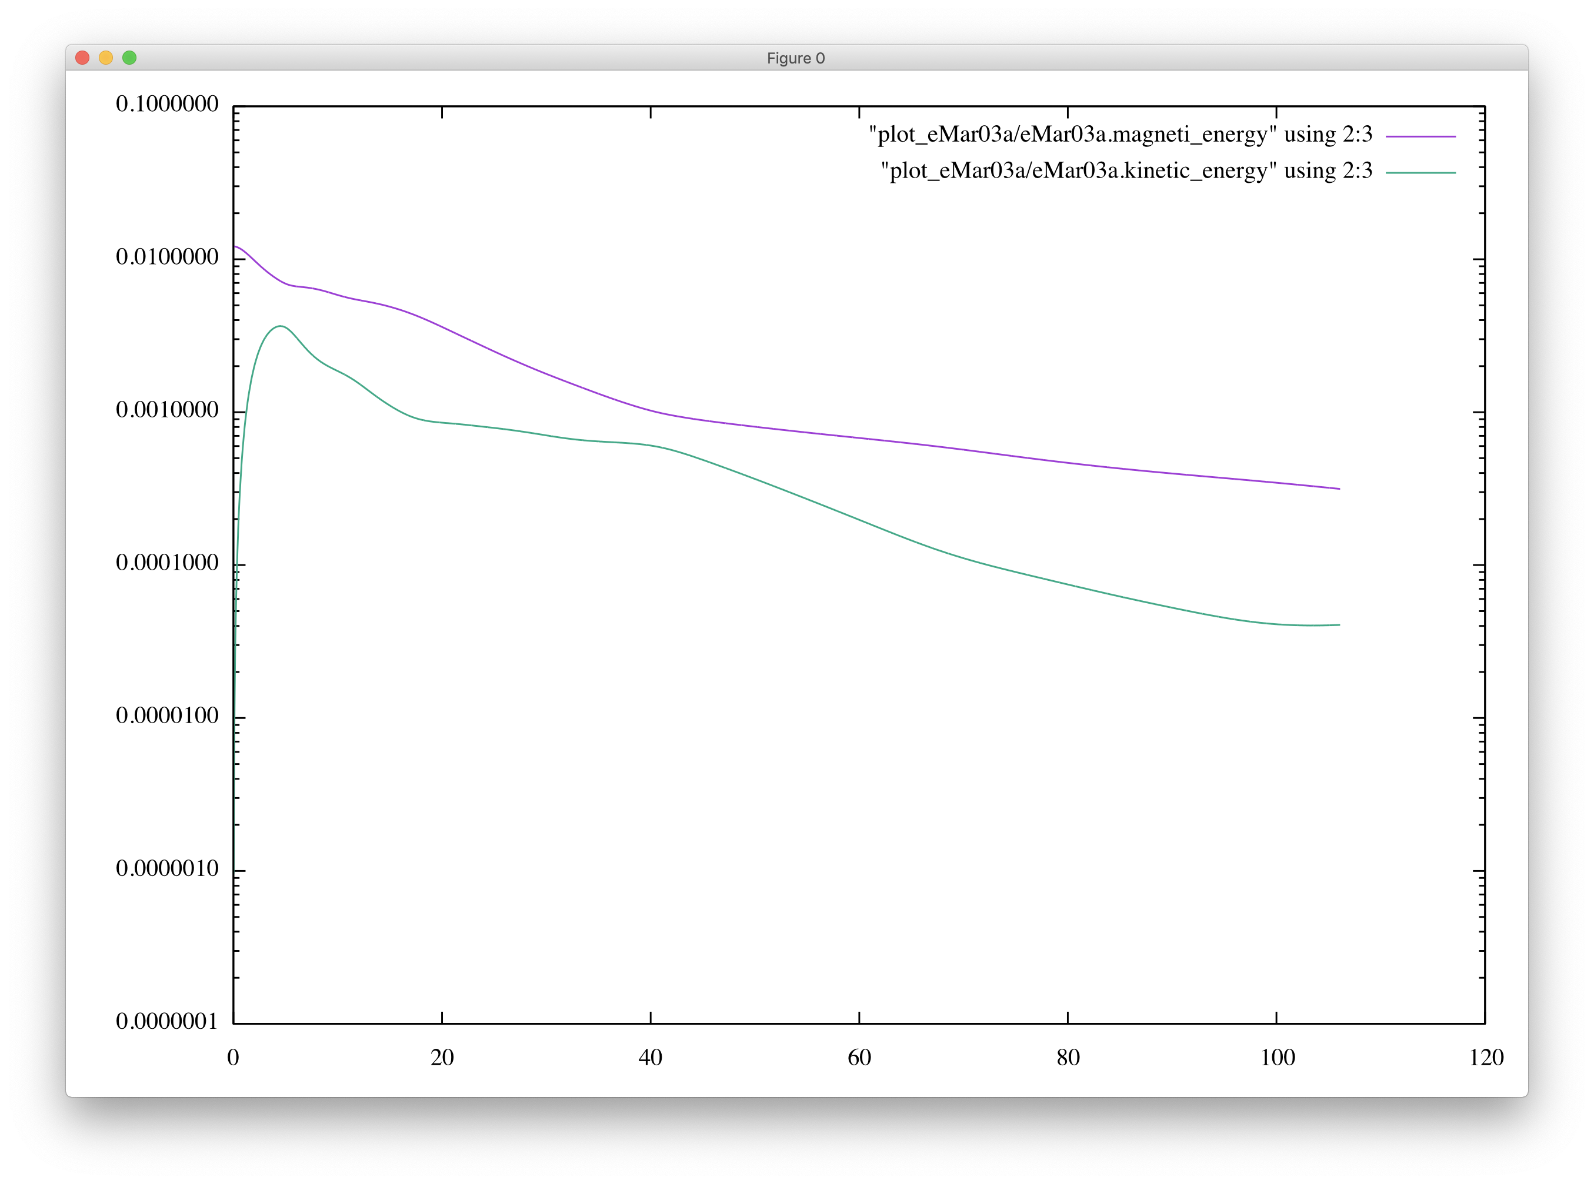
境界条件の変更
Notes:
Rigid境界の方が自然界で一般的
問題になるのは流れのエネルギーが消えてしまうこと

Slide 12
新たな初期条件の導入
リング磁場
非常に強い流れが起きる
⇒ シミュレーションの発散の原因
Notes:
Rigid境界の方が自然界で一般的
問題になるのは流れのエネルギーが消えてしまうこと

Slide 13
新たな初期条件の導入
解決策
リングの力を弱める ⇒弱めすぎると構造に変化が見られない
リングの数を増やす ⇒球面調和関数の導入
Notes:
リングの数を増やすとお互いのリングが縮まるのを妨げるため、発散を防ぐことができる

Slide 14
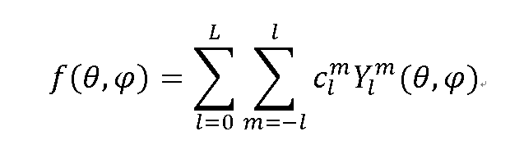
新たな初期条件の導入
球面調和関数とは？
球面上の関数 f(θ,φ) を展開するのに用いられる関数群のこと。 f(θ,φ) は球面調和関数の線形和で表される。
定数
球面調和関数
Notes:
リングの数を増やすとお互いのリングが縮まるのを妨げるため、発散を防ぐことができる

Slide 15
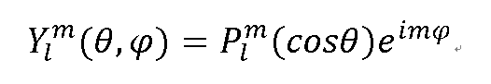
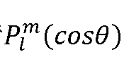
新たな初期条件の導入
球面調和関数の式
ルジャンドル陪関数 ：θ方向の展開を表す
(l,m)はそれぞれ緯度方向と経度方向のモードを表している ⇒ 磁気リングの数を調節できる
Notes:
リングの数を増やすとお互いのリングが縮まるのを妨げるため、発散を防ぐことができる

Slide 16
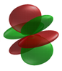
新たな初期条件の導入
モード：負の領域と正の領域のペアの数
例：(l,m)=(3,1)のとき、Y(3,1)~=A*cos(3θ)*cos(φ)
緯度方向
経度方向
＋
ー
ー
＋
＋
＝
＋
＋
ー
ー
https://ja.wikipedia.org/wiki/%E7%90%83%E9%9D%A2%E8%AA%BF%E5%92%8C%E9%96%A2%E6%95%B0
Notes:
赤は性の領域、緑は負の領域を示す
リングの数を増やすとお互いのリングが縮まるのを妨げるため、発散を防ぐことができる

Slide 17
新たな初期条件の導入
初期磁気ポテンシャル
Ar = AMP * r * (sin(πr)) * Plm(cosθ) * cos(mφ)
(l,m)=(3,1),(3,2),(3,3) の３パターンでシミュレーション
Notes:
リングの数を増やすとお互いのリングが縮まるのを妨げるため、発散を防ぐことができる

Slide 18
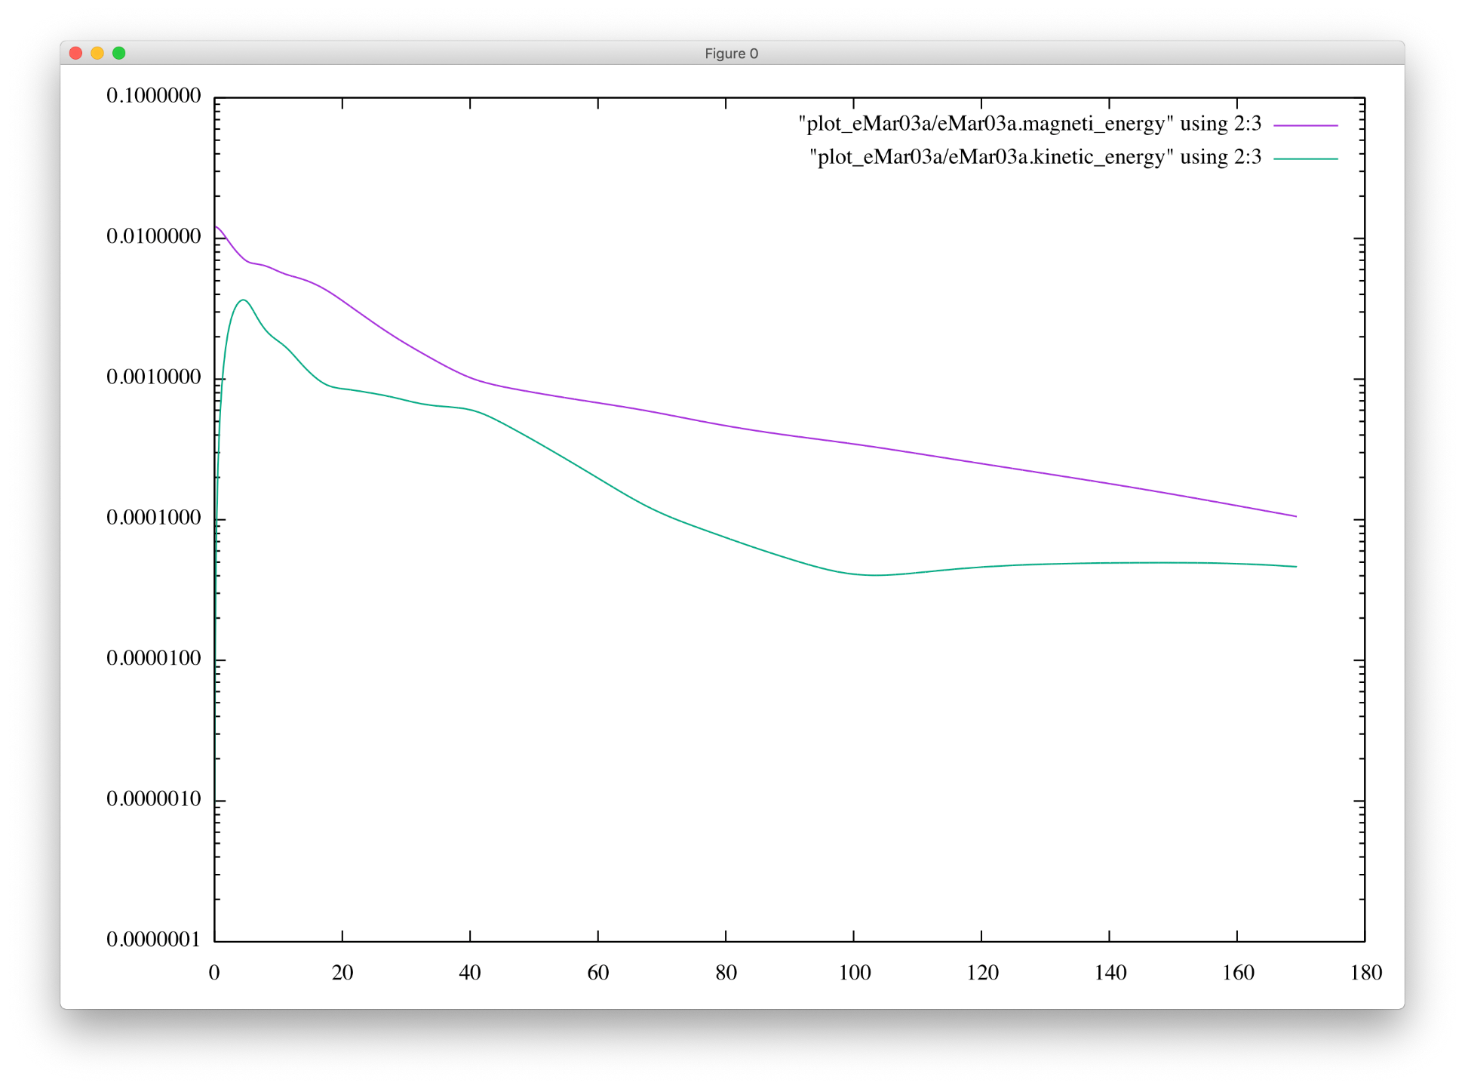
構造の発見（l=3,m=1）
Notes:
リングの数を増やすとお互いのリングが縮まるのを妨げるため、発散を防ぐことができる

Slide 19
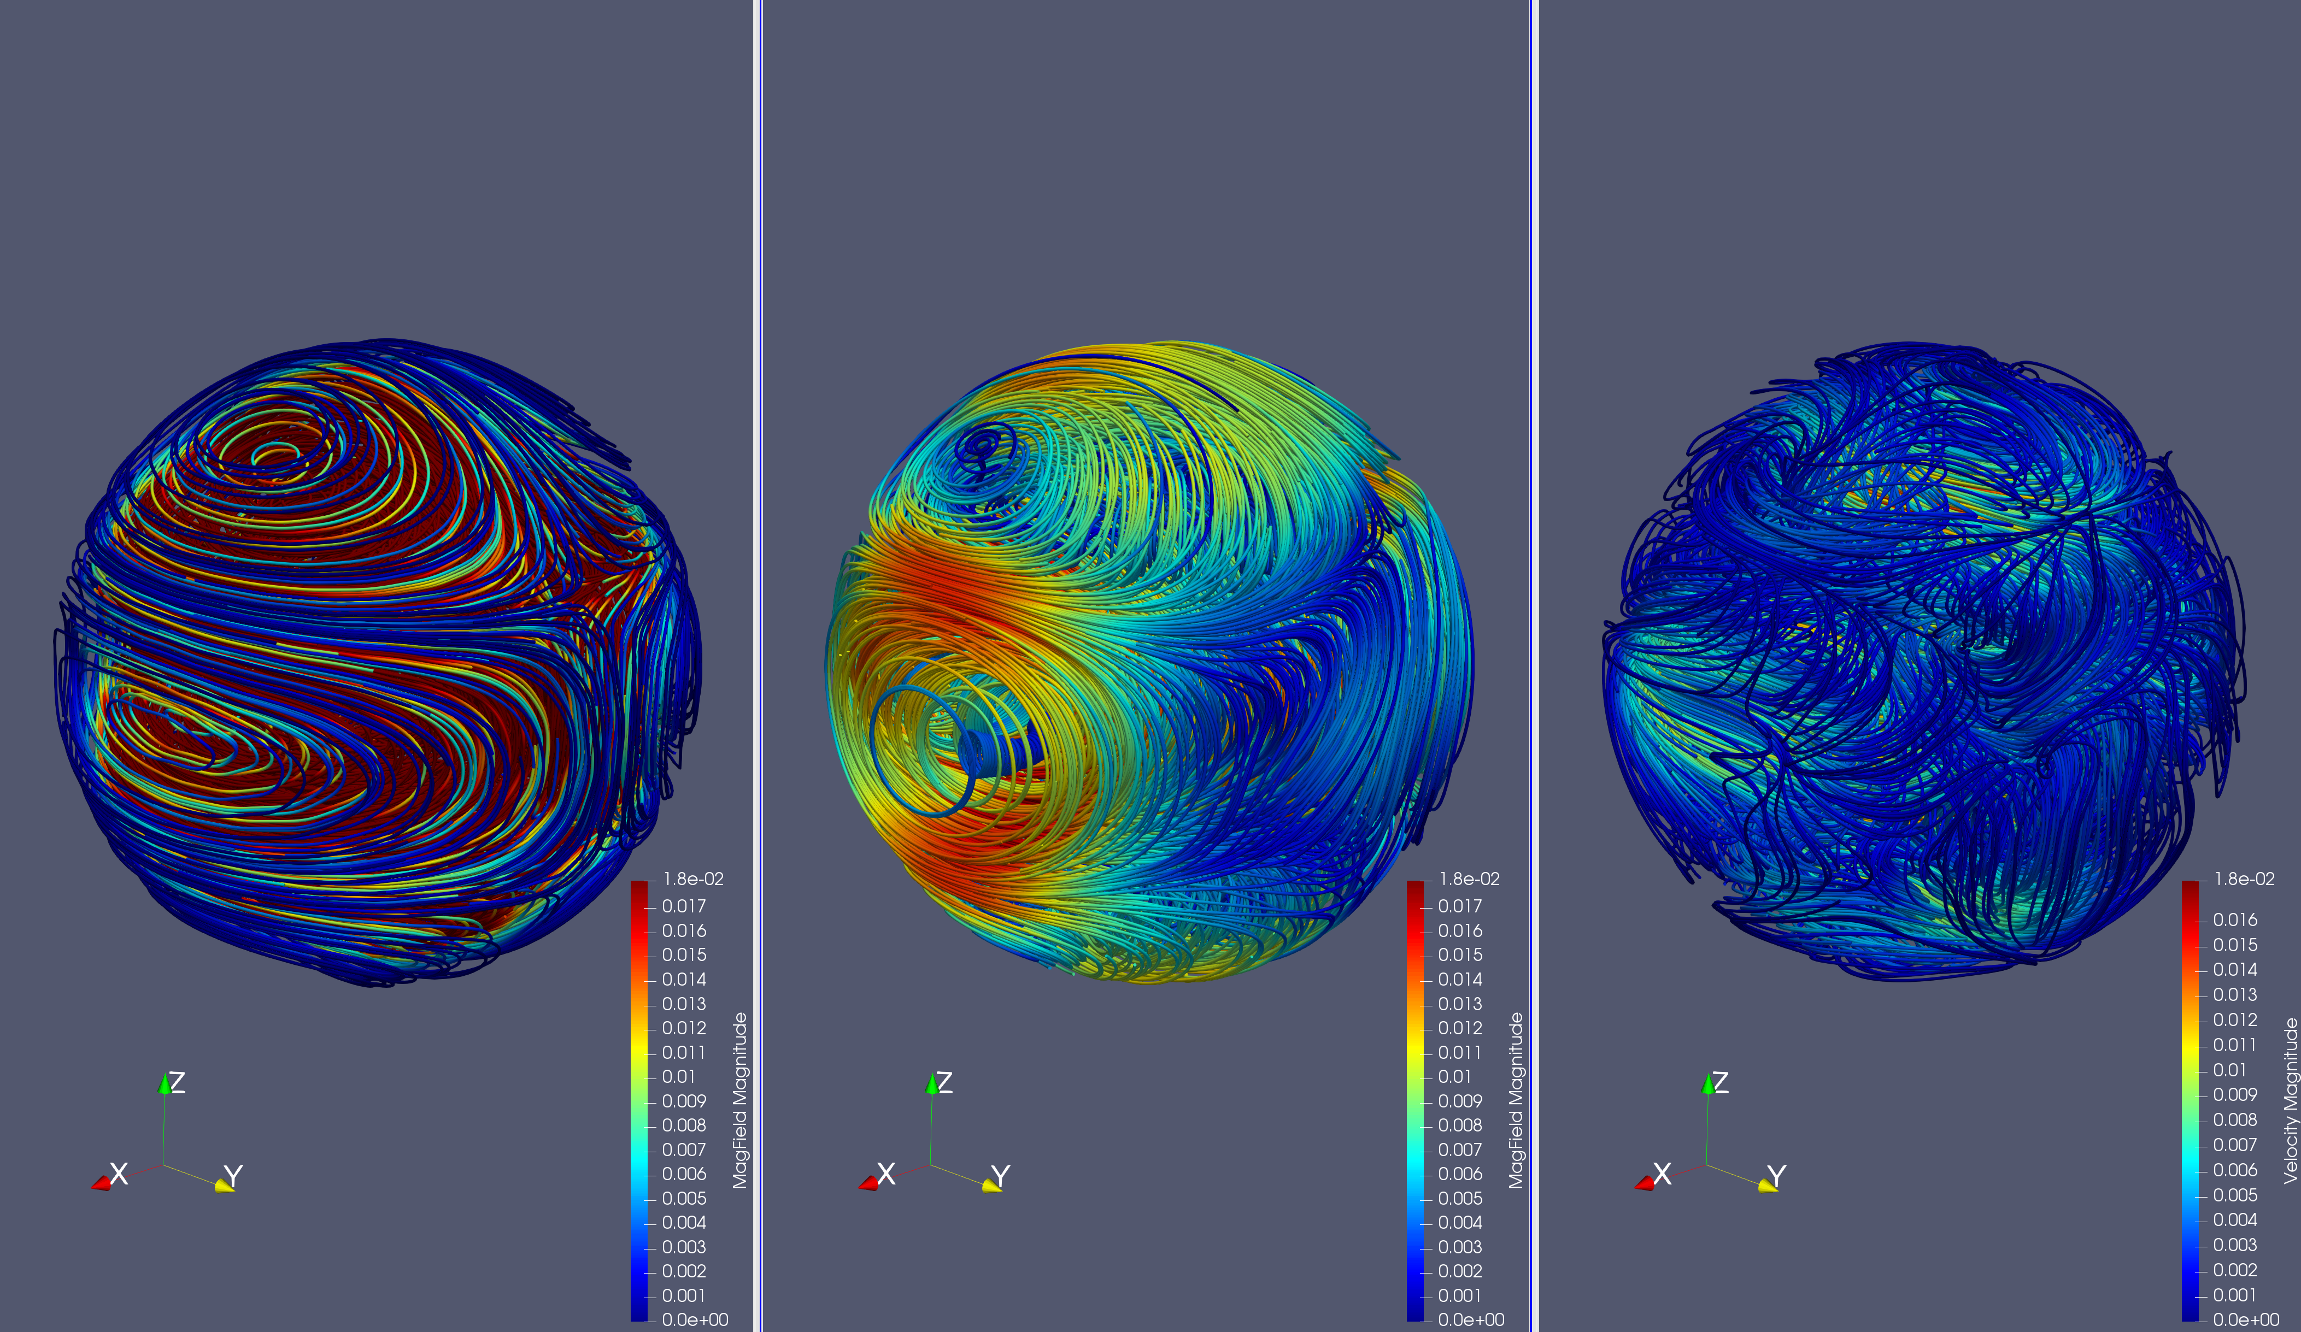
構造の発見（l=3,m=1）
「初期磁場」「緩和磁場(t=144)」「緩和流れ場(t=144) 」
Notes:
リングの数を増やすとお互いのリングが縮まるのを妨げるため、発散を防ぐことができる

Slide 20
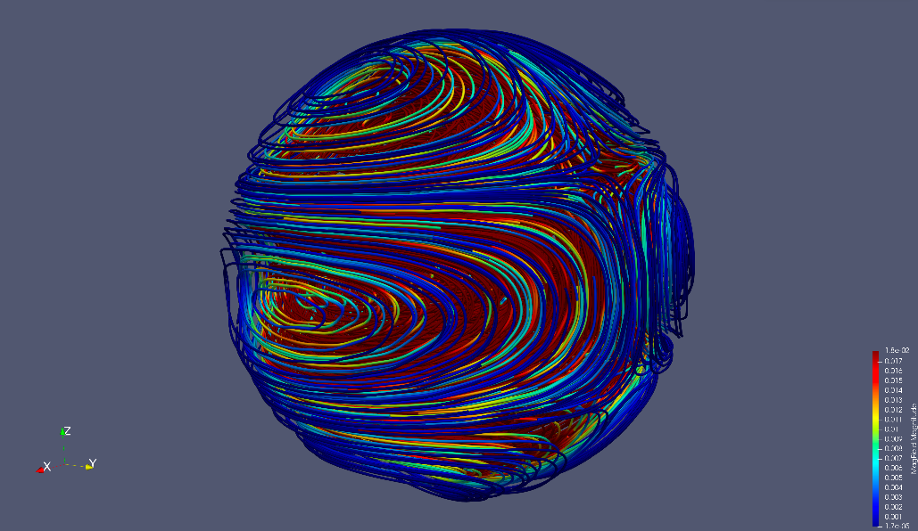
構造の発見（l=3,m=1）
初期磁場
Z
X
Y
Notes:
As you know, Fortran is very popular in High Performance Computing or HPC.
And, this language is very powerful for computer simulations.
And as you know, Fortran has been revised for many times including some major revises such as this one.
We call the last two revisions “the Modern Fortran”.
These revisions introduce some new and very useful features to the language such as …

Slide 21
構造の発見（l=3,m=1）
緩和状態
磁場と流れ場
Z
X
Y
Notes:
As you know, Fortran is very popular in High Performance Computing or HPC.
And, this language is very powerful for computer simulations.
And as you know, Fortran has been revised for many times including some major revises such as this one.
We call the last two revisions “the Modern Fortran”.
These revisions introduce some new and very useful features to the language such as …

Slide 22
構造の発見（l=3,m=1）
赤道断面
磁力線の輪が縮まり、流れの駆動力になる
X
Y
流れによって磁力線が引き伸ばされる
Notes:
As you know, Fortran is very popular in High Performance Computing or HPC.
And, this language is very powerful for computer simulations.
And as you know, Fortran has been revised for many times including some major revises such as this one.
We call the last two revisions “the Modern Fortran”.
These revisions introduce some new and very useful features to the language such as …

Slide 23
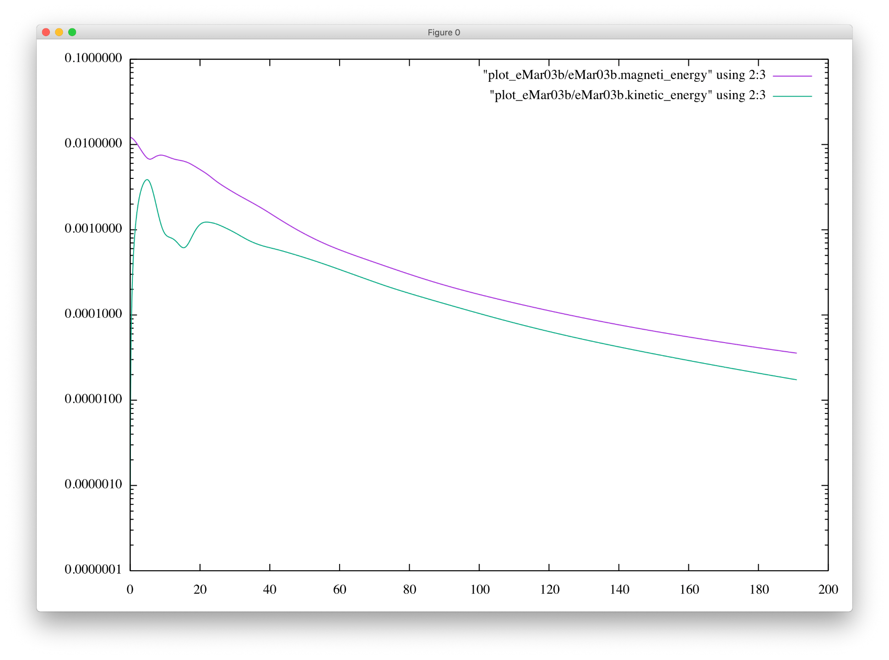
構造の発見（l=3,m=2）
Notes:
リングの数を増やすとお互いのリングが縮まるのを妨げるため、発散を防ぐことができる

Slide 24
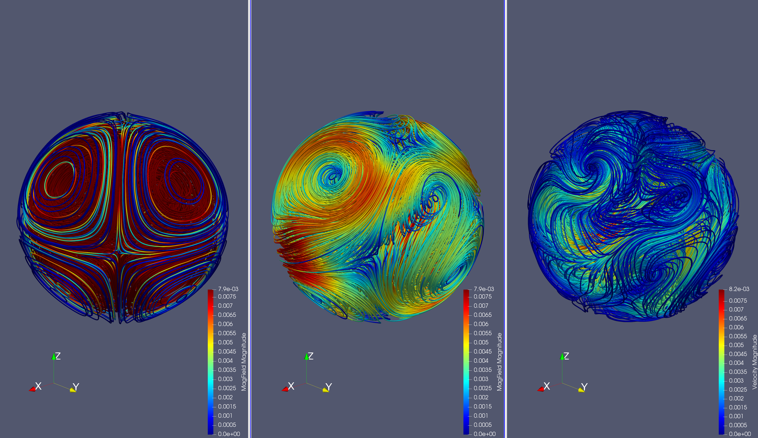
構造の発見（l=3,m=2）
「初期磁場」「緩和磁場(t=190)」「緩和流れ場(t=190) 」
Notes:
リングの数を増やすとお互いのリングが縮まるのを妨げるため、発散を防ぐことができる

Slide 25
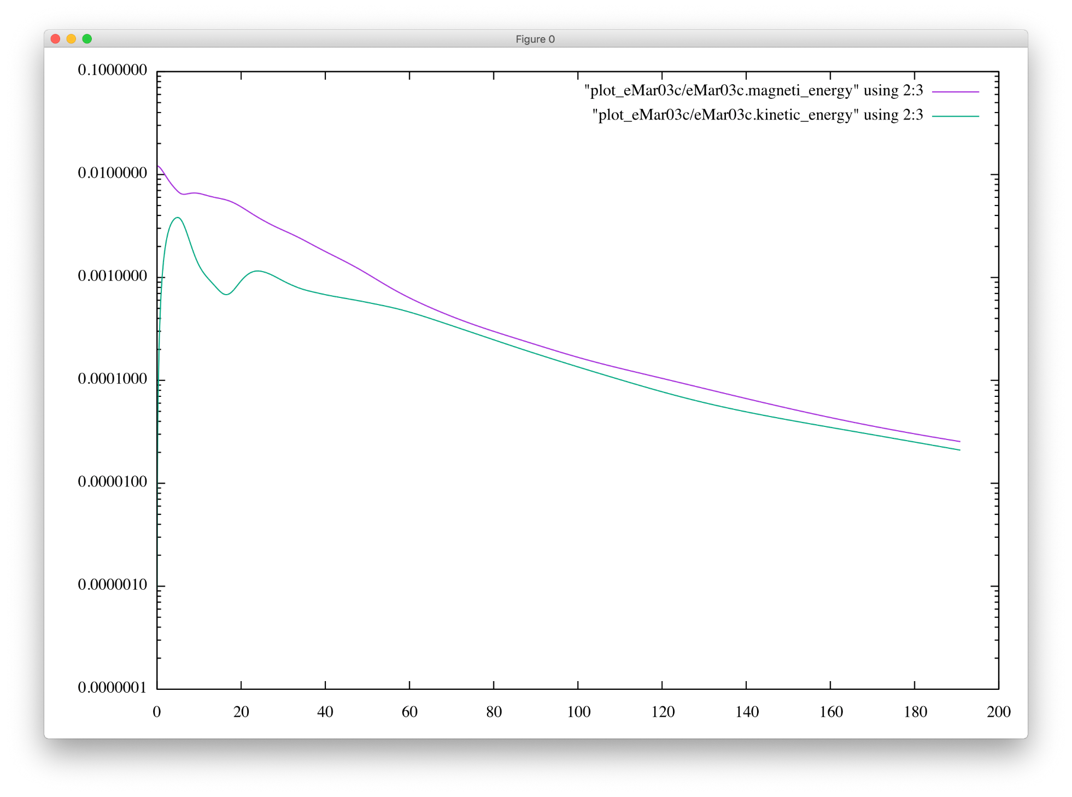
構造の発見（l=3,m=3）
Notes:
リングの数を増やすとお互いのリングが縮まるのを妨げるため、発散を防ぐことができる

Slide 26
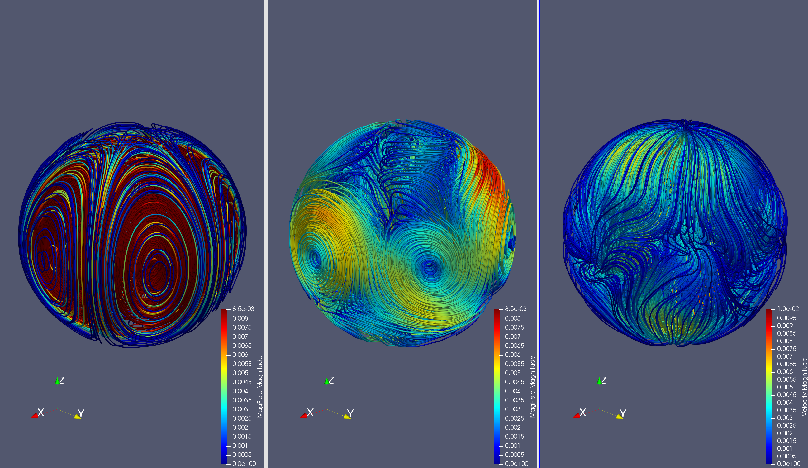
構造の発見（l=3,m=3）
「初期磁場」「緩和磁場(t=190)」「緩和流れ場(t=190) 」
Notes:
リングの数を増やすとお互いのリングが縮まるのを妨げるため、発散を防ぐことができる

Slide 27
構造の発見（l=3,m=3）
初期磁場
Z
X
Y
Notes:
As you know, Fortran is very popular in High Performance Computing or HPC.
And, this language is very powerful for computer simulations.
And as you know, Fortran has been revised for many times including some major revises such as this one.
We call the last two revisions “the Modern Fortran”.
These revisions introduce some new and very useful features to the language such as …

Slide 28
構造の発見（l=3,m=3）
緩和状態
磁場と流れ場
Z
X
Y
Notes:
As you know, Fortran is very popular in High Performance Computing or HPC.
And, this language is very powerful for computer simulations.
And as you know, Fortran has been revised for many times including some major revises such as this one.
We call the last two revisions “the Modern Fortran”.
These revisions introduce some new and very useful features to the language such as …

Slide 29
今後の課題
(l,m)=(3,2)の構造解析
その他(l,m)を変えてシミュレーション ⇒(l,m)に対応した緩和状態の表
解像度を高める
Notes:
リングの数を増やすとお互いのリングが縮まるのを妨げるため、発散を防ぐことができる

Slide 31
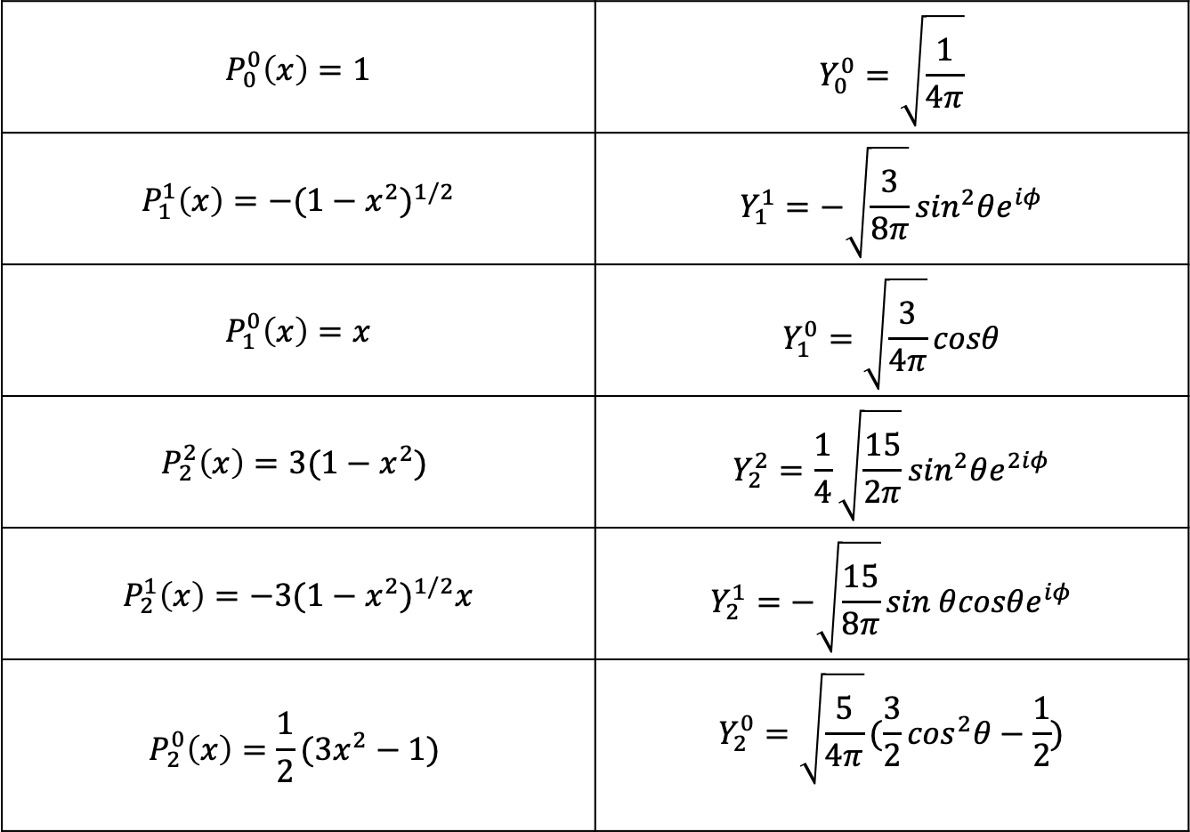
ルジャンドル陪関数と球面調和関数
$$P_{0}^{0}\left(x\right)=1$$ | $$Y_{0}^{0}=\sqrt{\frac{1}{4π}}$$
$$P_{1}^{1}\left(x\right)={−(1−x^{2})}^{1/2}$$ | $$Y_{1}^{1}=−\sqrt{\frac{3}{8π}}\sin^{2}θe^{iφ}$$
$$P_{1}^{0}\left(x\right)=x$$ | $$Y_{1}^{0}=\sqrt{\frac{3}{4π}}cosθ$$
$$P_{2}^{2}\left(x\right)={3(1−x^{2})}^{ }$$ | $$Y_{2}^{2}=\frac{1}{4}\sqrt{\frac{15}{2π}}\sin^{2}θe^{2iφ}$$
$$P_{2}^{1}\left(x\right)={−3(1−x^{2})}^{1/2}x$$ | $$Y_{2}^{1}=−\sqrt{\frac{15}{8π}}\sin^{ }θ{cosθe}^{iφ}$$
$$P_{2}^{0}\left(x\right)={\frac{1}{2}(3x^{2}−1)}^{ }$$ | $$Y_{2}^{0}=\sqrt{\frac{5}{4π}}(\frac{3}{2}\cos^{2}θ−\frac{1}{2})$$
Notes:
リングの数を増やすとお互いのリングが縮まるのを妨げるため、発散を防ぐことができる

Slide 32
構造の発見（l=3,m=3）
緩和磁場
Z
X
Y
Notes:
As you know, Fortran is very popular in High Performance Computing or HPC.
And, this language is very powerful for computer simulations.
And as you know, Fortran has been revised for many times including some major revises such as this one.
We call the last two revisions “the Modern Fortran”.
These revisions introduce some new and very useful features to the language such as …

Slide 33
構造の発見（l=3,m=1）
緩和状態
磁場と流れ場
Z
X
Y
Notes:
As you know, Fortran is very popular in High Performance Computing or HPC.
And, this language is very powerful for computer simulations.
And as you know, Fortran has been revised for many times including some major revises such as this one.
We call the last two revisions “the Modern Fortran”.
These revisions introduce some new and very useful features to the language such as …

Slide 34
構造の発見（l=3,m=1）
初期磁場
Z
X
Y
Notes:
As you know, Fortran is very popular in High Performance Computing or HPC.
And, this language is very powerful for computer simulations.
And as you know, Fortran has been revised for many times including some major revises such as this one.
We call the last two revisions “the Modern Fortran”.
These revisions introduce some new and very useful features to the language such as …

Slide 35
構造の発見（l=3,m=1）
緩和状態
磁場と流れ場
Z
X
Y
Notes:
As you know, Fortran is very popular in High Performance Computing or HPC.
And, this language is very powerful for computer simulations.
And as you know, Fortran has been revised for many times including some major revises such as this one.
We call the last two revisions “the Modern Fortran”.
These revisions introduce some new and very useful features to the language such as …

Slide 36
L=3,M=1 流れ場と磁場の重ね合わせ （XY平面 極付近）
小さいリング
大きいリング
X
Y
Notes:
As you know, Fortran is very popular in High Performance Computing or HPC.
And, this language is very powerful for computer simulations.
And as you know, Fortran has been revised for many times including some major revises such as this one.
We call the last two revisions “the Modern Fortran”.
These revisions introduce some new and very useful features to the language such as …

Slide 37
L=3,M=1 磁場
Z
X
Y
Notes:
As you know, Fortran is very popular in High Performance Computing or HPC.
And, this language is very powerful for computer simulations.
And as you know, Fortran has been revised for many times including some major revises such as this one.
We call the last two revisions “the Modern Fortran”.
These revisions introduce some new and very useful features to the language such as …

Slide 38
L=3,M=1 流れ場
Z
X
Y
Notes:
As you know, Fortran is very popular in High Performance Computing or HPC.
And, this language is very powerful for computer simulations.
And as you know, Fortran has been revised for many times including some major revises such as this one.
We call the last two revisions “the Modern Fortran”.
These revisions introduce some new and very useful features to the language such as …

Slide 39
L=3,M=1 流れ場と磁場の重ね合わせ
Z
X
Y
Notes:
As you know, Fortran is very popular in High Performance Computing or HPC.
And, this language is very powerful for computer simulations.
And as you know, Fortran has been revised for many times including some major revises such as this one.
We call the last two revisions “the Modern Fortran”.
These revisions introduce some new and very useful features to the language such as …

